Slide 1




Slide 2


Welcome to The Presentation of ONLINE QUIZ Website
Submitted by
1.Saipreethi Mekapothula(2092933)
2.Sriya Reddy kowkuntla(2092132)
3. Sukwinder singh(2092985)
4. Ashish puri(2092652)

Slide 3
ABSTRACT
A quiz is a form of game or mind sport in which players attempt to answer questions correctly about a certain or variety of subjects.
Now-a-days, online quizzes are the most popular form of entertainment for the people who are web surfers.
The online quizzes are free to play and some websites offer prizes for entertainment.
Many online quizzes are setup to actually test their own attributes. This also creates motivation of learning and gaining of knowledge among the people in which they are interested in.

Slide 4

Advantages
Online quizzes can be given without an instructor, as the online quiz is virtual.
We can easily test ourself anytime, anywhere, at home, at work or even on the go on multiple devices like smartphone, tablet, laptop.
Online quizzes improve Knowledge Retention and Transfer.
Engage Learners.
Asses Knowledge.
Motivate Learners.

Slide 5

Disadvantages
The astounding variety of materials available in the internet, but not all of them are good quality.
Online quiz is not the most user-friendly interface and can take a bit to learn.
Questions forms are limited by what the tool allows.
Making use of digital devices can harm our health.

Slide 6

Technologies used:
HTML: Hyper Text Markup Language is the standard language foe creating documents for the world wide web. An HTML is a text file, which contains the elements, in the form of tags that a web browser uses to display text, multimedia objects, and hyperlinks using HTML.
JavaScript: JavaScript is an easy-to-use language, developed by Netscape, which can be embedded in HTML pages to make them more interactive and dynamic.
CSS: CSS is the language for describing the presentation of Web pages, including colors, layout and fonts.

Slide 7

Working Model of Website
Home page

Slide 8
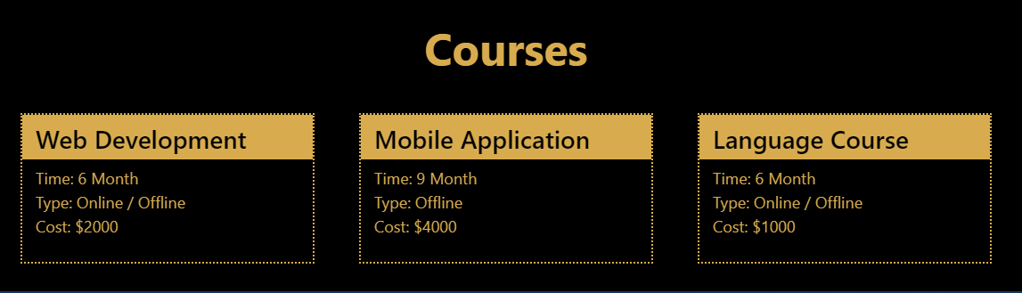
When we click on the courses tab on the Toolbar, it displays all the courses offered by the website with all the information like Duration, Cost and Type.

Slide 9
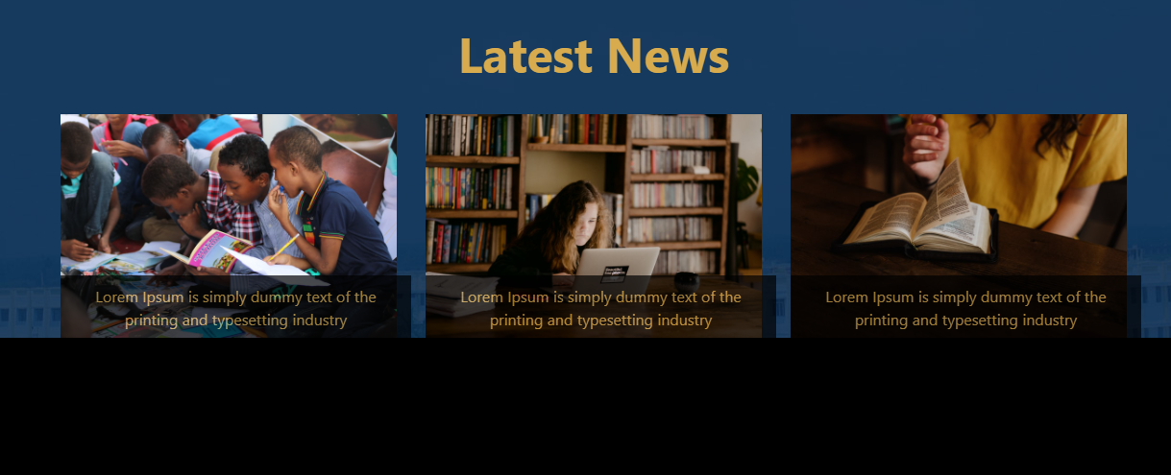
This is the view of the Latest News tab in our website, when we click on that tab on the homepage, it displays the latest News regarding our website.

Slide 10
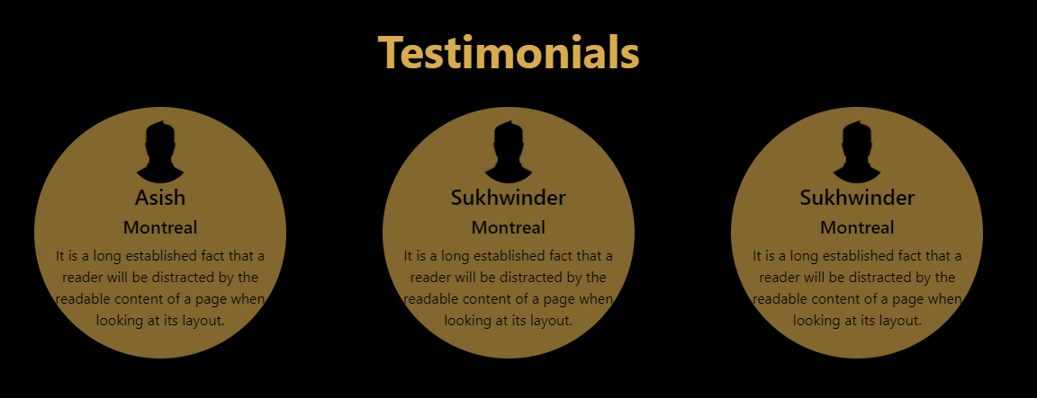
Testimonials

Slide 11
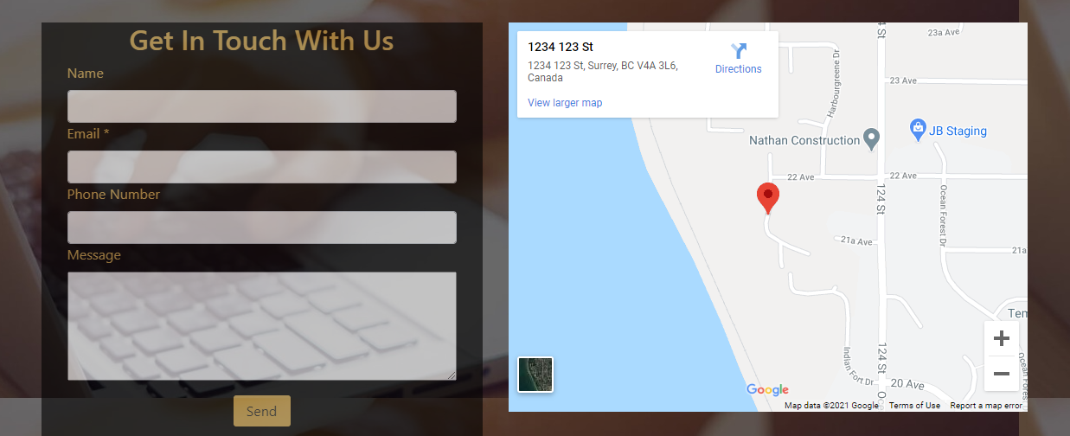
This is the info in Contact tab, where you can fill-out the details and send us, then we can contact you and also you can visit us by this location.

Slide 12
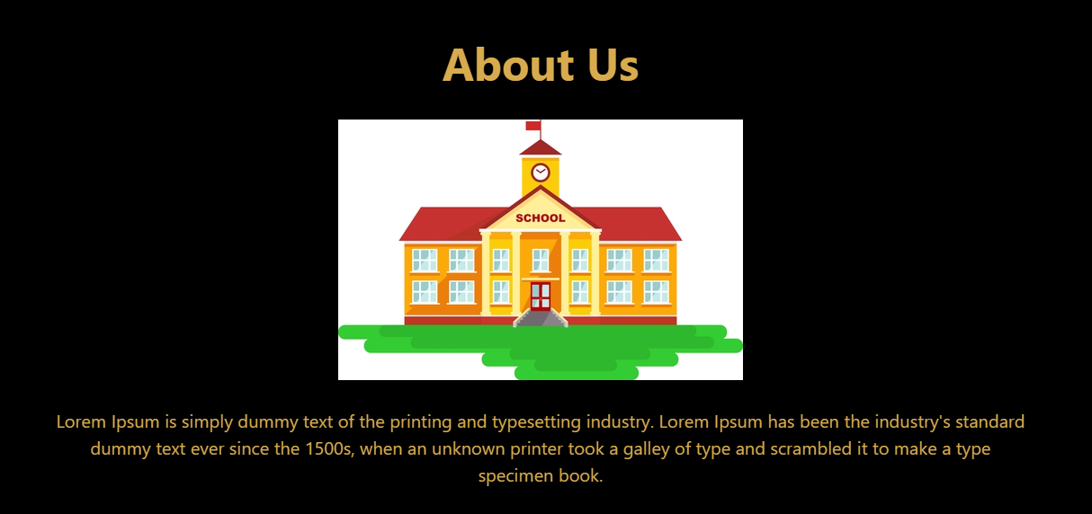
This is the part of our website, where you can know about us.

Slide 13
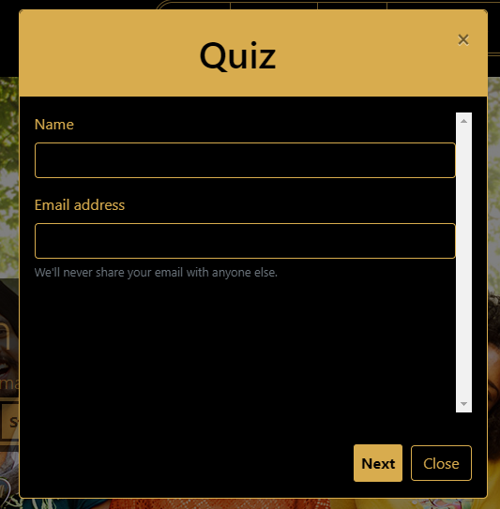
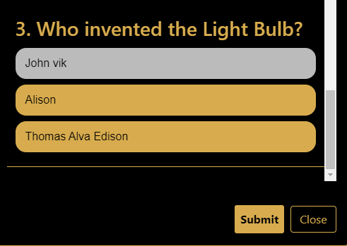
To start a quiz ,first you need to enter all the details and then you can start your quiz and answer all your questions and submit them.

Slide 14
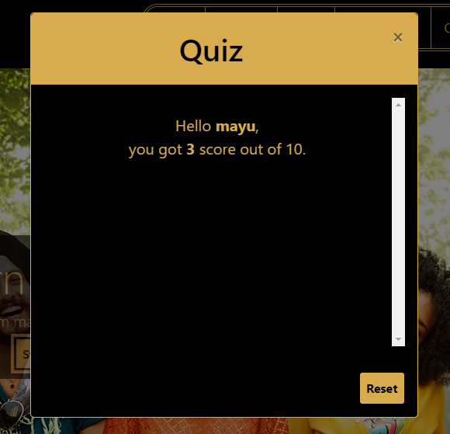

After answering all the questions, the output is displayed as below.

Slide 15
References
https://www.google.com.
https://www.google.com/search?q=online+quiz+ppt&rlz=1C1CHBF_enIN917IN917&oq=&aqs=chrome.5.35i39i362l8...8.394004946j0j15&sourceid=chrome&ie=UTF-8.
https://en.wikipedia.org/wiki/Online_quiz.

Slide 16


